Slide 1
Solvent extraction
solid phase extraction (SPE) A SOLID-LIQUID EXTRACTIVE TECHNIQUE

Slide 2
SOLID PHASE EXTRACTION
INTRODUCTION
the use of solid-phase extraction (SPE) is designed for rapid, selective sample preparation and purification prior to the chromatographic analysis (e.g. HPLC, GC, TLC).
one or more analytes from a liquid sample are isolated by extracting, partitioning, and/or adsorbing onto a solid stationary phase.
In SPE, the stationary phase (a sorbent or resin) binds either the analyte or impurity through strong but reversible interactions
The stationary phase will adsorb polar molecules which can be collected with a more polar solvent.

Slide 3
SOLID PHASE EXTRACTION
PRINCIPLE
the partitioning of compounds between two phases of solid and liquid and there must be greater affinity for the solid phase than for the sample matrix. The compounds retained on the solid phase can be removed by eluting solvent with a greater AFFINITY FOR ANALYTES
PROCEDURE
A typical solid phase extraction involves four steps:
1. CONDITIONING :The cartridge is equilibrated or conditioned with a solvent to wet the sorbent. When silica particles are bonded with a hydrophobic phase, they become “waterproof” and must be conditioned in order to interact with aqueous samples

Slide 4
SOLID PHASE EXTRACTION
This is accomplished by passing methanol or a similar solvent through the sorbent bed. The solvent penetrates into the bonded layer and permits water molecules and analyte to diffuse into the bonded phase.
2. RETENTION (LOADING):
solution containing the analyte is percolated through the solid phase. Ideally, the analyte and some impurities are retained on the sorbent i.e. the analyte and other sample constituents are adsorbed on the sorbent extraction bed.
3. RINSING (WASHING):
The sorbent is then washed to remove impurities

Slide 5
SOLID PHASE EXTRACTION
4. ELUTION
Elution removes the desired analyte, perhaps leaving other constituents behind depending on the relative strengths of interaction with the solid phase or solubility in the eluting solvent.
SAMPLE PROCESSING:
The powdered phase is generally placed in a small cartridge, similar to a plastic syringe. Sample is placed in the cartridge and forced through by means of a plunger (positive pressure) or a vacuum (negative pressure), or by centrifugation.

Slide 6
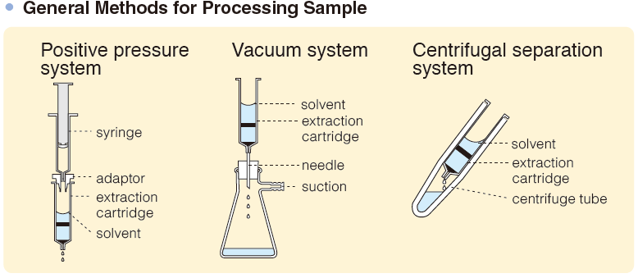
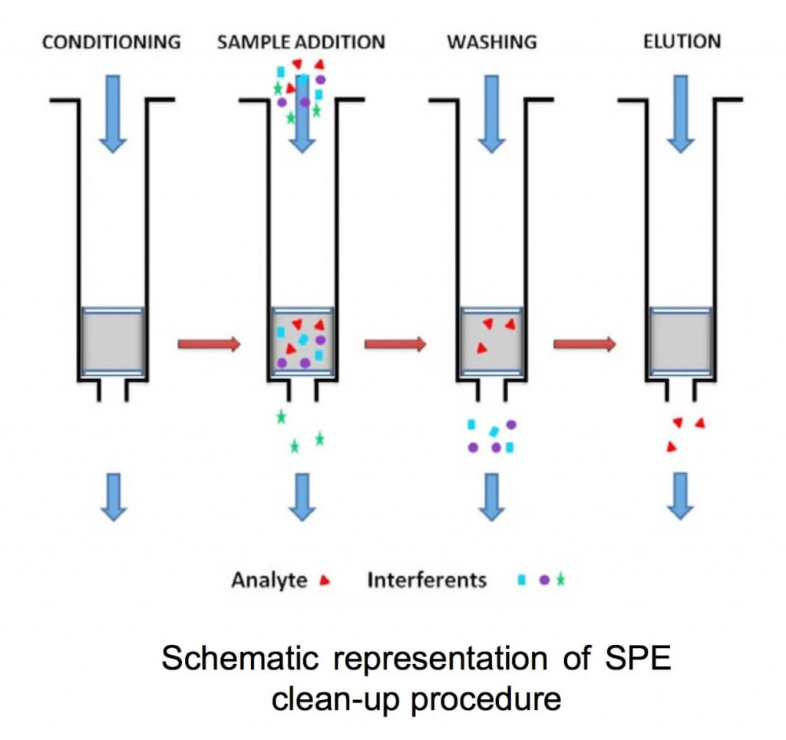
SOLID PHASE EXTRACTION
GENERAL METHODS OF PROCESSING SAMPLE
SPE CLEANUP PROCEDURE

Slide 7
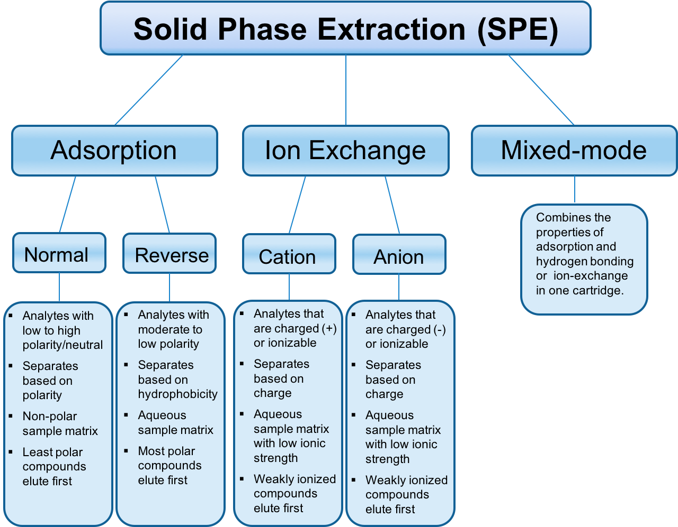
TYPES OF SPE

Slide 8
SOLID PHASE EXTRACTION
SORBENTS (SOLID PHASE):
A stationary phase of polar functionally bonded silica with short carbons chains frequently makes up the solid phase. In this technique, a particular type of organic functional group is chemically bonded to a solid surface, for example, powdered silica. A common example is the bonding of C18 chains on silica, with particle sizes on the order of 40 µm. The bonded hydrocarbon creates a virtual liquid phase, into which hydrophobic organic analytes in an aqueous sample can partition and be extracted
OTHER SORBENTS:
Sorbents are available in long chain lengths(C20 and C30)for isolation of hydrophobic molecules. “Universal sorbents” have been developed that will sorb a group of structurally similar compounds.
EXAMPLE: a synthetic polymer of N-vinylpyrrolidone(tophalf ofmolecule)anddivinylbenzene(bottomhalf). It provides hydrophilicity for wetting and hydrophobicity for analyte retention.

Slide 9
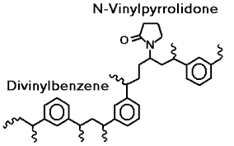
SOLID PHASE EXTRACTION

Slide 10
SOLID PHASE EXTRACTION
PHASEPOLYMERICS:
Polystyrene divinyl benzene orother polymer-based supports are also commonly used, especially for ion exchanger based SPE phases. Chelating groups (iminodiacetate, 8-hydroxyquinoline) based SPEs are widely used for online or off-line extraction and pre-concentration of trace metals, e.g., from sea-water.
Advantages
Being stable over a wide pH range,
They do not possess residual silanol groups (Si-OH groups) that can interact with, for example, metal ions or other cationic species.
The particles are spherical, while silica-based SPE particles are irregular in shape, and

Slide 11
SOLID PHASE EXTRACTION
The polymeric particles have been designed to be wettable.
They typically have higher capacity than silica-based particles.
DUAL PHASES:
The use of two different phases can extend the range of compounds extracted. Three types are used, mixed mode, layered, and stacked phases.
In the mixed mode, two different types of chemically bonded phases are mixed together in the cartridge. An example is a mixture of C8 and cation exchange particles.
In the layered mode, the two different phases are packed one on top of the other.
Stacked phases use two cartridges in series to provide enhanced separations. The first two modes are more readily adapted to automation since only a single cartridge is used.

Slide 12
SOLID PHASE EXTRACTION
SPE CARTRIDGES:
The powdered phase (Sorbent) is generally placed in a small cartridge (polypropylene syringe barrel), similar to a plastic syringe., with typically 500 mg of packing in 3 or 5ml syringe barrels. Smaller 1ml syringes packed with 100 mg are becoming more popular because of reduced sample and solvent requirement and faster cleanup times, and even smaller packed beds down to 10mg are available
Advantages of SPE
Cleaner Samples SPE enables you to target just your analyte of interest. Being able to specifically target these analytes will lead to a much cleaner sample.

Slide 13
SOLID PHASE EXTRACTION
2. Batch Processing: The ability to batch process multiple samples is another great advantage. Whether you are working in a fixed 96-well plate or cartridges on top of a vacuum manifold, you are able to more easily automate your work flow.
3. Concentration: SPE concentrates your analytes of interest as a function of just performing
Solid-Phase Microextraction (SPME):
Microextraction is a simplified and miniaturized sample preparation technique aimed at zero or minimum solvent consumption

Slide 14
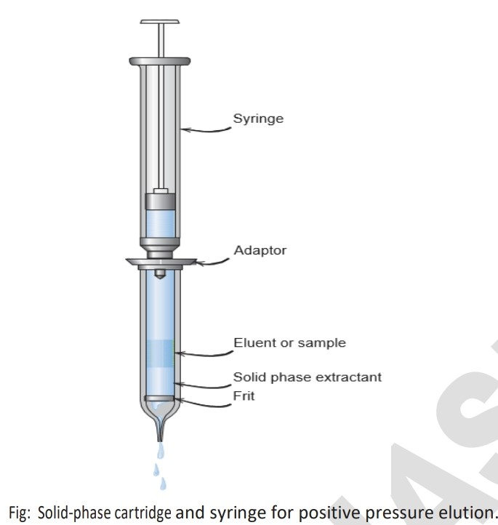
SOLID PHASE EXTRACTION

Slide 15
SOLID PHASE EXTRACTION
microextraction uses only microliter, or even smaller volumes, of extraction media.
A solid phase microextraction (SPME) uses fused silica fiber coated with a stationary phase. Fiber is immersed in analyte.
The organics diffuse partition into polymeric coating as function of D (distribution ratio).
The stage of operation is: conditioning of solvent followed by sample application, washing with solvent and finally the process of elution.
The solid phase contains bonded silica or special material. Florisil or alumina is also used.

Slide 16
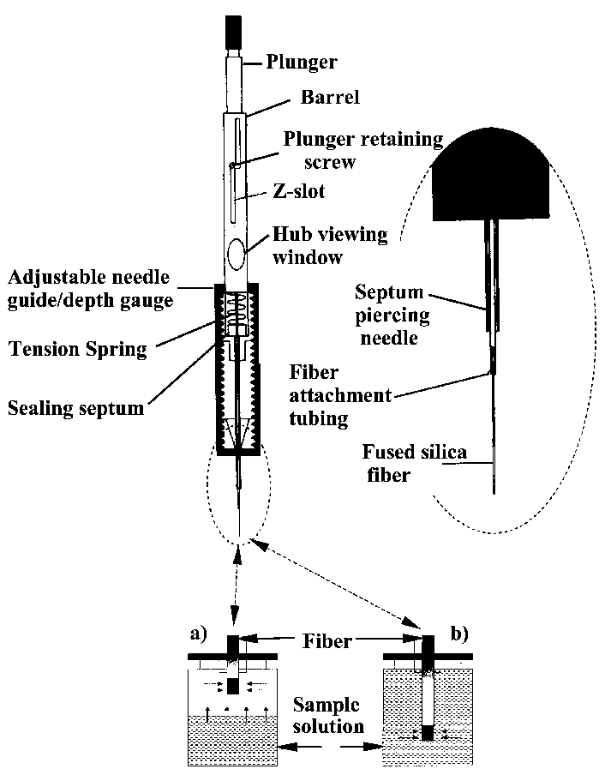
SOLID PHASE EXTRACTION

